Slide 1
Socket Programming
Computer Networks Lab 3
Section B, C, D

Slide 2
Client-Server communication
Server
 passively waits for and responds to clients
 passive socket 
Client
 initiates the communication  must know the address and the port of the server
 active socket

Slide 3
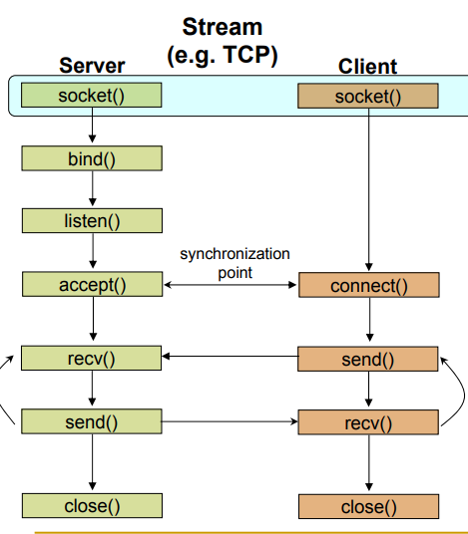
Client - Server Communication

Slide 4
Socket creation in C: socket()
int sockid = socket(family, type, protocol);
sockid: socket descriptor, an integer (like a file-handle) 
family: integer, communication domain, e.g., 
PF_INET, IPv4 protocols, Internet addresses (typically used)
PF_UNIX, Local communication, File addresses 
type: communication type 
SOCK_STREAM - reliable, 2-way, connection-based service
SOCK_DGRAM - unreliable, connectionless, messages of maximum length 
protocol: specifies protocol 
IPPROTO_TCP
IPPROTO_UDP  usually set to 0 (i.e., use default protocol) 
upon failure returns -1

Slide 5
Assign address to socket: bind()
associates and reserves a port for use by the socket
 int status = bind(sockid, &server_addr, size);
 sockid: integer, socket descriptor 
server_addr: struct sockaddr_in, the (IP) address and port of the machine 
size: the size (in bytes) of the addrport structure 
status: upon failure -1 is returned

Slide 6

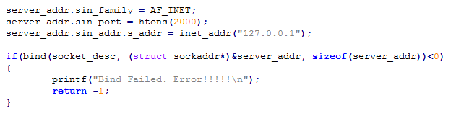
bind()- Example with TCP

Slide 7
listen for connections: listen()
int status = listen(sockid, queueLimit); 
sockid: integer, socket descriptor 
queuelen: integer, # of active participants that can “wait” for a connection 
status: 0 if listening, -1 if error 
listen() is non-blocking: returns immediately 
The listening socket (sockid)  is never used for sending and receiving  is used by the server only as a way to get new sockets

Slide 8
Establish Connection: connect()
The client establishes a connection with the server by calling connect() 
int status = connect(sockid,& server_addr, addrlen); 
sockid: integer, socket to be used in connection 
server_addr: struct sockaddr: address of the passive participant 
addrlen: integer,
status: 0 if successful connect, -1 otherwise 
connect() is blocking

Slide 9
Incoming Connection: accept()
The server gets a socket for an incoming client connection by calling
accept()  int s = accept(sockid, &clientAddr, &addrLen); 
s: integer, the new socket descriptor (used for data-transfer)  sockid: integer
clientAddr: struct sockaddr, address of the active participant  filled in upon return 
addrLen: sizeof(clientAddr): value/result parameter  must be set appropriately before call  adjusted upon return 
accept() 
is blocking: waits for connection before returning 
dequeues the next connection on the queue for socket (sockid)

Slide 10
Exchanging data with stream socket
int count = send(sockid, msg, msgLen, flags); 
msg: const void[], message to be transmitted 
msgLen: integer, length of message (in bytes) to transmit 
flags: integer, special options, usually just 0 
count: # bytes transmitted (-1 if error) 
int count = recv(sockid, recvBuf, bufLen, flags); 
recvBuf: void[], stores received bytes 
bufLen: # bytes received 
flags: integer, special options, usually just 0 
count: # bytes received (-1 if error) 
Calls are blocking  returns only after data is sent / received

Slide 11
Socket close in C: close()
When finished using a socket, the socket should be closed 
status = close(sockid); 
sockid: the file descriptor (socket being closed) 
status: 0 if successful, -1 if error 
Closing a socket 
closes a connection (for stream socket)
frees up the port used by the socket

